Slide 1


Slide 2

Round robin brainstorming

Slide 3

Round brain storming
Course Code : MSTS502P
Course Title :
Credits : 1
Prerequisites : NA
Antirequisites : NA

Slide 4
Definition
Round robin brainstorming is a structured technique used in group settings to generate ideas or solutions to a specific problem or challenge.
It ensures that every participant has an equal opportunity to contribute, promoting inclusivity and preventing dominant individuals from monopolizing the discussion

Slide 5

Round Robin Brain storming

Slide 6
Benefits of Round Robin
Improves problem-solving: When everyone is pushed to think critically about a problem, you can generate more possible solutions — eventually, one of them will be a game-changer.
Fosters inclusivity: When team members present a diverse range of perspectives and fresh ideas, it can lead to more comprehensive proposals with fewer (or no) blind spots.
Increases engagement: When every member is obliged to participate, engagement increases both during the session and outside it. This is especially true in remote work scenarios, where speaking up might be more challenging.

Slide 7
Promotes innovation: If every participant feels they can share their ideas, you’ll get more unconventional ideas and creative possibilities and produce innovative solutions that may not have otherwise emerged.
Enhances team cohesion: When you have an open discussion in which every suggestion is taken seriously, it can help team members build rapport, strengthen relationships, and improve how they all work together. ‍
Mitigates groupthink: When you no longer have just one or two people taking charge of a brainstorm, you minimize the risk of groupthink. Instead of everyone just going along with the most vocal and passionate participants, they get to hear varying and contradictory viewpoints.

Slide 8
Pairing Round Robin with Design thinking
Round robins are especially beneficial for those who prioritize design thinking, a system that puts customer needs at the center of your brainstorm.
Since a round robin discussion is inherently more inclusive, the ideas you generate are more likely to emphasize empathy and a human-centered approach.
This can be key to solving some of your biggest challenges and coming up with ingenious ways to help your business stand out and deliver results.

Slide 9
How to run Round Robin brainstorming session
To host a round robin session, you’ll need to consider the size of your team. If you plan to involve a larger number of people (typically more than seven people), split everyone up into smaller groups. Some items you’ll need to prepare before meeting include:
A piece of paper/index cards or online collaboration platform where people can add their ideas
A physical or online whiteboard to lay out or rank the suggestions
A clock or timer to set time limits for each person and keep the exercise moving
A team leader or third party who doesn’t take part in the brainstorming exercise but can act as a guide to keep everyone on track and on time

Slide 10
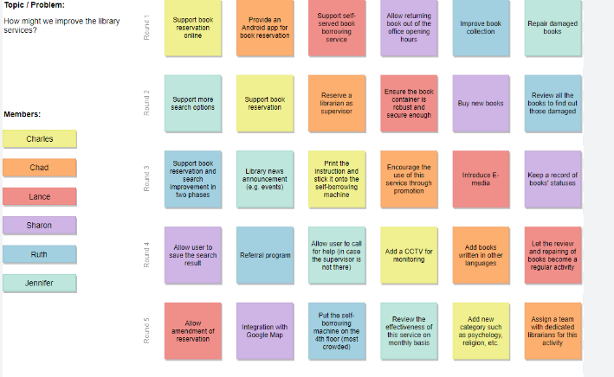
How to run Round Robin brainstorming session

Slide 11
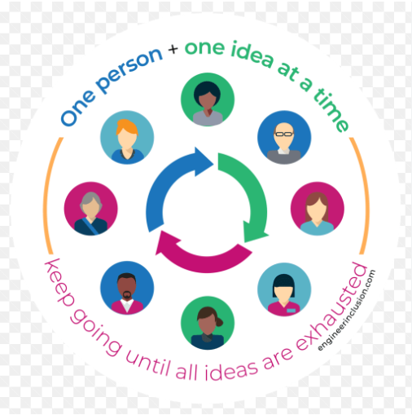
General steps for Round Robin brainstorming

Slide 12
Round Robin brainstorming is a structured method of idea generation where each participant in a group has an opportunity to contribute ideas in a systematic and equitable manner. Here are the general steps for conducting Round Robin brainstorming:
Define the Objective
Select a Facilitator
Assemble the Group
Explain Round Robin Rules
Establish a Time Limit
Start the Round Robin
Encourage Unfiltered Ideas
Document Ideas
Rotate Participants
Clarify and Build on Ideas
Summarize and Discuss
Prioritize and Evaluate
Capture Results

Slide 13
General steps for Round Robin brainstorming
Once you have these elements ready to go, you can create an outline of the steps for the brainstorming meeting. There are a few ways you can run round robins, but the high-level steps look like this:
If you have a larger group, split your team up and/or seat your smaller group around a table. If you’re in a remote or hybrid meeting, split your team up into virtual meeting rooms and share a link to your digital whiteboard or collaboration platform.
If you have multiple groups working on the same challenge, consider gamifying this experience and having each group compete against the others for the most creative ideas.
Clearly define the challenge or problem, and make it visible throughout the process (e.g., by including it at the top of your whiteboard).

Slide 14
4.Set a time limit for each round. Typically, five minutes is a good amount of time for rapid ideation.
5.Establish ground rules for the group discussion (e.g., all ideas are welcome; keep ideas short and to the point; no talking while the clock is running; etc.).
6.Pass around ideas over the course of a few rounds.
7.Evaluate ideas, consolidate duplicates, and define strengths and weaknesses.
8.Determine the best, most viable options.
9.Outline the next steps for your new opportunity.

Slide 15
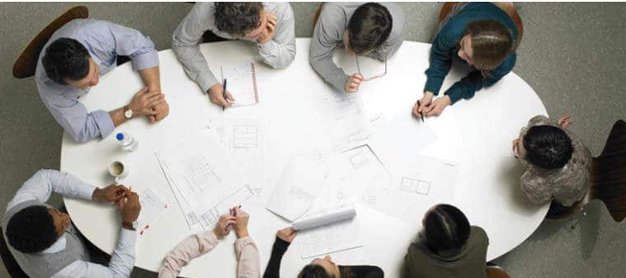
Divergent Round Robin brainstorming

Slide 16
Divergent Round Robin brainstorming
Divergent round robin combines the round robin technique with divergent thinking, the process of collaboratively generating and exploring varying unconventional suggestions.
This technique is useful if you want to be able to generate the most unusual ideas in the shortest amount of time.
In divergent round robins, you use a sticky notepad or virtual sticky notes. If you’re in person, place the sticky notepad in the middle of the table. If you’re remote,
show your team members how to select a new sticky note from your online whiteboard.
Once you set a timer, the first person takes the sticky notepad, writes their idea on the first page, and slaps the sticky note in the middle of the table. Or, if you’re meeting remotely, drag it to the middle of the online whiteboard. Then it’s the next person’s turn to do the same thing, and they continue going around until time runs out. At the end, you have many ideas in front of you to discuss, weed out, and build on.

Slide 17
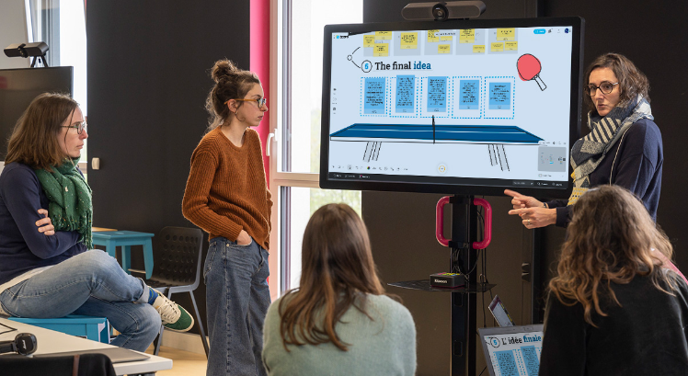
Interactive Round Robin brainstorming

Slide 18
Interactive Round Robin brainstorming
In this round robin method, every participant receives their own paper or document to write on at the same time.
During a set amount of time, each person writes down their proposed solutions to the challenge.
They don’t talk or share their ideas with anyone yet.
After the time is up, each participant passes their ideas over to another person in the group. Then they elaborate on the idea they’ve been handed, hence the “Yes, and…” nickname for this method.
(It alludes to an improvisation technique in which improvisers accept their scene partner’s lines and add on to the story.)
Next, continue passing the original ideas around until each person has contributed to every suggestion.
You’ll see that the idea goes from the seedling of a proposal to a more robust and comprehensive possible solution.

Slide 19
Find the Round Robin technique for you
One aspect that ties all of these group brainstorming methods together is the use of visual collaboration to increase efficiency.
When you lay out your thoughts and opinions on a page — whether in person or online – you open up space to get creative with your team’s toughest problems.
Structure helps speed up this creative process — and starting with a template helps get you up and running faster.
With Mural’s round robin brainstorming template, you can help your team diminish overbearing opinions and uncover innovative resolutions quickly.
This framework invites users to lay it all out there, take equal hold of the reins, and come up with the next big ideas that’ll drive your business forward.

Slide 20
Advantages of Brainstorming:
Diverse Perspectives: Brainstorming encourages the contribution of ideas from various participants, bringing in diverse perspectives and insights.
Creativity:
Team Building:
Increased Engagement
Rapid Idea Generation
Open Communication
Problem-Solving:
Flexibility

Slide 21
Advantages and disadvantages
There are some obvious advantages to round-robin brainstorming:
The brainstorming is calm, organised and structured.
All participants have their say, regardless of hierarchy, prestige or communication preferences.
The communication of ideas encourages more ideas.

Slide 22
disadvantage of Brainstorming:
Social Dynamics:
Groupthink:
Evaluation Pressure:
Time-Consuming:
Idea Quality:
Overreliance on Verbal Expression
Implementation Challenges
Dependency on Facilitator

Slide 23
Advantages and disadvantages
The advantages may be offset by some disadvantages:
Even if the brainstorming is structured, the discussion and evaluation of ideas is based on the same principles as a classic brainstorming: Extroverted employees and/or superiors can easily influence the next steps.
Here, of course – as with other brainstorming formats – the moderator is particularly challenged.
One brainstorming rule is that participants can contribute but do not have to. In this variant, however, everyone has to get involved. While in a classic format it may not be so important if individual participants contribute less, in this format it is directly noticeable if the person asked does not contribute a new idea. This may reinforce the rejection of the format.

Slide 24
Question :
What are the hallmarks of empathy?
Expertise in building human relationships by understanding others
Optimism even in the face of failure
Persuasiveness
Self-deprecating sense of humour
Notes:
Answer:
The hallmark of empathy is "expertise in building human relationships by understanding others."
Explanation: Empathy is the ability to understand and share the feelings of others. This inherently involves relating to people on a deeper level by recognizing their emotions and fostering meaningful connections. Let me know if you'd like to delve deeper into the concept!

Slide 25
Question :
. Identify the oldest method of brainstorming?
○ Star bursting method
○ Brain writing 6-3-5 method
○ Round robin brainstorming
○ Charette procedure
Notes:
Ans: c
The oldest method of brainstorming is often considered to be the Round Robin brainstorming technique. This method involves participants taking turns sharing ideas in a structured manner, which helps ensure everyone has a chance to contribute

Slide 26
Question :
Which of the following is an advantage of Round Robin Brainstorming?
○ It encourages dominant members to take control of the discussion.
○ It ensures quieter members have an opportunity to contribute.
○ It eliminates the need for structured facilitation.
○ It focuses on evaluating ideas during the brainstorming session.
Notes:
Ans: b
It ensures quieter members have an opportunity to contribute.
Round Robin Brainstorming allows everyone to share their ideas in turn, which helps ensure that all voices are heard, especially those who might be quieter

Slide 27
Question :
During Round Robin Brainstorming, ideas are generated by:
○ Allowing everyone to speak simultaneously
○ Having participants take turns sharing ideas in sequence
○ Voting on the best ideas at the start of the session
○ Assigning one person to generate ideas for the group
Notes:
Ans: b
In Round Robin Brainstorming, ideas are generated by:
Having participants take turns sharing ideas in sequence.
This method allows everyone to contribute without interruptions, making it easier to gather a variety of ideas.

Slide 28

THANK YOU

